Slide 1

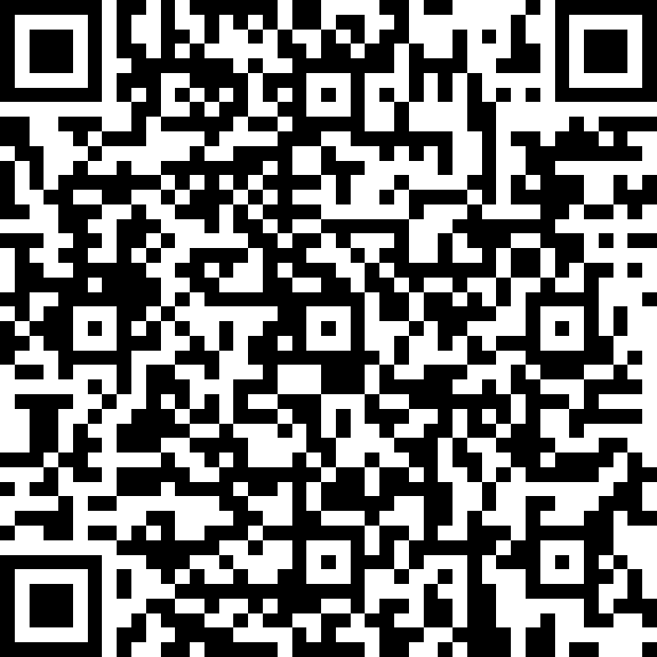
Microsoft Entra ID Governance POC Feedback
https://aka.ms/IGAPOCSurvey

Slide 2
Microsoft Entra ID Governance
Employee Lifecycle Automation
Proof of concept – Pre-work Call

Slide 3
Proof of concept (PoC) | Goals
Automate Employee lifecycle
Demonstrate the value of Microsoft Entra ID Governance in your environment:
Discovery: Review the current onboarding and lifecycle processes for external identities, in order to identify
What is the current HR system and onboarding process?
How does the organization manage lifecycle for identities after onboarding?
Is there any automation in place that helps alleviate all manual / disjoined processes?
Define: Criteria for success will be based on a successful provisioning of employee with its lifecycle (Joiner/Mover/Leaver)
Evaluate: Evaluate the result of the POC by collecting customer feedback and team insights

Slide 4
Microsoft Entra ID Governance Journey | POC scope
Examples
Advanced customizations
Core capabilities
Customization
Advanced data extraction / Transformation / load with external source of records
Customized logic apps with 3rd party connectors
Legacy workloads with on-prem IGA and cloud only accounts
Etc.
Maintenance
Phases
Provisioning from multiple source of records to multiple targets
Complex mapping/transformation
On-prem apps with 3rd party ECMA connectors
Multiple Identities
Deployment
Provision non-prod users from HR system with key attributes
Provision non-prod users to up to 4 SaaS apps
Run Lifecycle Workflows for J/M/L (On-demand)
Demo of Custom Extension capabilities
Simple attributes flow/transformation
Single tenant
On-prem apps with built-in connectors
POC
(You are here)

Slide 5
Scenario’s Key Requirements
Your organization uses a cloud HR like Workday or SuccessFactors or willing to use the generic API-driven inbound provisioning
Your organization is evaluating an automated way to provision users from HR sources as well as manage the lifecycle of such identities
Your organization is looking to automate lifecycle of Joiner/Mover/Leaver scenarios through specific events (triggers)
Microsoft Entra ID Governance SKU - How to start a Microsoft Entra ID Governance Trial)
Account with Cloud app administrator, Identity Governance Administrator, Privileged Role Administrator or Global administrator on the target tenant

Slide 6
PoC Stakeholders
Common customer stakeholders
We will engage the following stakeholders at specific stages of the POC:
Identity team: Microsoft Entra ID Global Administrator
Azure logic app contributor (or similar)
HR Business process manager
Security Admin
Compliance Manager
Development Teams (Graph API, Custom workflows)
Microsoft stakeholder
PoC driver: Microsoft engineer who will guide you during the PoC process

Slide 7
PoC | Timeline
Delivery stages
SaaS Apps provisioning
Lifecycle workflows
HR provisioning
Close-out
3 hours
1 hour
3 hours
1 hour
8 hours
Logistics
Each stage will only require participation of a subset of stakeholders from customer
Times are estimated based on scenario complexity

Slide 8
PoC | Pre-work
Perform a discovery of current customer’s processes for user’s lifecycle
Collect Architectural diagrams (if existing)
We advise utilizing a non-production HR environment along with trial instances of Microsoft Entra ID for testing purposes (please request a trial if necessary)
If a dedicated non-production HR environment is unavailable, we recommend pursuing the API-driven Inbound Provisioning Proof of Concept (POC).
Identify technical owners of the PoC resources, in case remediation/investigations are needed

Slide 9
PoC | Phase 1: HR Provisioning
SaaS Apps provisioning
Lifecycle workflows
HR provisioning
Close-out
3 hours
1 hour
3 hours
1 hour
Session (1 hour): Cloud HR and API driven provisioning
Who? → All teams
Working session
2 hours, depending on complexity of scenario
Role | Responsibility
Microsoft Entra ID Global Admin | →Activate Trial and initial setup
Cloud Application Administrator | → Provisioning App configuration
Security Admin | →Ensure solution meets organizational security policies
Compliance Manager | → Ensure solutions complies with regulations
Development Teams | → Assist on build applications like custom workflows

Slide 10
PoC | Phase 2: SaaS Apps provisioning
SaaS Apps provisioning
Lifecycle workflows
HR provisioning
Close-out
3 hours
1 hour
3 hours
1 hour
Working session (1 hour)
Role | Responsibility
Microsoft Entra ID Global Admin | → Configure SCIM provisioning SaaS Apps in Microsoft Entra ID
Cloud Application Administrator | → Provisioning App configuration
On-prem App Administrator (Optional) | → Configure and Validate provisioning in on-premises App

Slide 11
PoC | Phase 3: Lifecycle Workflows
SaaS Apps provisioning
Lifecycle workflows
HR provisioning
Close-out
3 hours
1 hour
3 hours
1 hour
Working session (3 hour)
Role | Responsibility
Microsoft Entra ID Global Admin | →Activate Trial and initial setup
Lifecycle workflow administrator | →Setup Lifecycle Workflows
Security Admin | →Ensure solution meets organizational security policies
Compliance Manager | → Ensure solutions complies with regulations
Development Teams | → Assist on build applications like custom workflows

Slide 12
PoC | Phase 4: Close-out
SaaS Apps provisioning
Lifecycle workflows
HR provisioning
Close-out
3 hours
1 hour
3 hours
1 hour
Wrap-up session (1 hour)
Who?
→ All teams
→ Leadership team
Goal
Present POC results
Discuss strategy to further implement
Fill out POC closeout survey

Slide 13
Microsoft Entra ID Governance features used on this scenario
Feature | Description | Stage | Microsoft Entra ID Governance SKU
Lifecycle Workflows (LCW) J/M/L | Enables you to create workflows to automate key onboarding and offboarding tasks to manage your users' lifecycle at scale. | General Availability | Yes
LCW + Custom Extensions (Logic Apps) | Lifecycle Workflows can be used to trigger custom tasks via an extension to Azure Logic Apps. | General Availability | Yes
HR Driven Provisioning | HR driven provisioning is the process of creating digital identities based on a human resources system. | General Availability | No
API-driven inbound provisioning | API-driven inbound provisioning, the Entra ID provisioning service now supports integration with any system of record. | Public Preview | No
App provisioning | Entra ID application provisioning refers to automatically creating user identities and roles in the applications that users need access to | General Availability | No
Source
Microsoft Entra ID Governance licensing fundamentals
Notes:
The following governance features went GA and are part of the Microsoft Entra ID Governance SKU:
Lifecycle workflows (LCW) – Enables you to use custom workflows to automate identity lifecycle management tasks for your Microsoft Entra ID users by managing your joiner, mover, and leaver lifecycle processes. With LCW, you can leverage Microsoft Entra ID to confidently deploy workflows to configure out-of-the-box actions to onboard and offboard your employees.
LCW + Custom Extensions (Logic Apps) - Lifecycle Workflows can be used to trigger custom tasks via an extension to Azure Logic Apps.

Slide 14
Microsoft Entra ID Governance
Employee Lifecycle Automation
Proof of concept deployment
<<Subtitle or speaker name>>

Slide 15
Introduction
Historically, the IT staff has heavily relied on inconsistent processes to manage the creation, updating, and deletion of employees and their data within their identity providers.
Unfortunately, this traditional approach has posed several challenges, particularly when it comes to ensuring timely and accurate access provisioning.

Slide 16
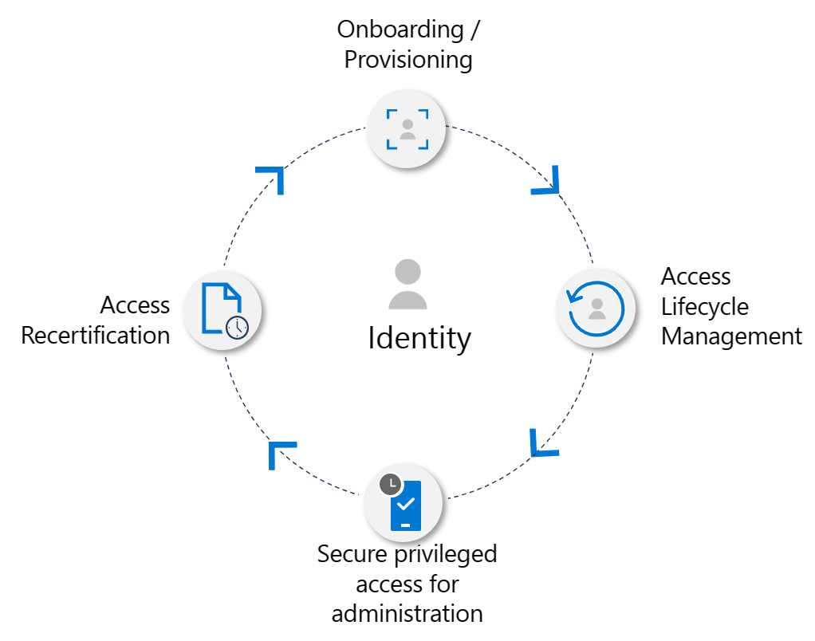
To address these issues and streamline the employee identity management process, organizations are increasingly adopting modern solutions and automated approaches. By leveraging advanced identity management systems and technologies, the IT staff can overcome the limitations of manual procedures and enhance efficiency.

Slide 17
Key benefits from using Microsoft Entra ID Governance
Increased user productivity: Typically, new hires undergo a two-week onboarding process to acquire access to essential resources. Microsoft Entra ID governance can this wait is significantly shortened. Through streamlined automation of the entire lifecycle, from initial provisioning to granting application access, the onboarding process becomes expedited and efficient
Cost savings: Through the automation of user lifecycles and the elimination of manual or disconnected tasks, IT administrators can redirect their attention towards more critical priorities
Increased Security: Streamline the automation of user departures, application access revocation, team and group removal as well as management of the lifecycle of guest accounts
Compliance: Adhering to compliance regulations is crucial for organizations. Implementing a robust identity lifecycle greatly aids in meeting these requirements

Slide 18
Modern Identity Management solutions
Automatic Provisioning
Efficient Access Management
Centralized Identity Governance
Self Service Capabilities
Audit and Reporting
Integration with HR systems
Notes:
These modern identity management solutions offer a range of benefits, including:
Automated Provisioning: With the implementation of automated workflows, the system can automatically create and update employee profiles, significantly reducing the need for manual intervention. This ensures that new employees are swiftly granted access to the necessary resources, and updates to existing employee profiles are accurately reflected in the identity provider.
Efficient Access Management: By utilizing role-based access control and permissions, the IT staff can easily assign the appropriate access rights to employees based on their job roles and responsibilities. This enables precise access provisioning, minimizing the risk of data breaches caused by over-privileged accounts.
Centralized Identity Governance: A centralized identity management system allows for better visibility and control over all employee identities. IT staff can efficiently monitor access privileges and ensure compliance with security policies and regulations.
Self-Service Capabilities: Modern identity management solutions often provide self-service options for employees to manage certain aspects of their identity, such as password resets and profile updates. This empowers employees, reduces the burden on IT support, and improves overall productivity.
Audit and Reporting: Comprehensive logging and reporting features in these solutions enable IT staff to track access changes, review user activity, and generate compliance reports. This ensures transparency and accountability within the organization.
Integration with HR Systems: Integrating the identity management system with HR databases ensures that employee data is always up-to-date. When an employee joins, moves within, or leaves the organization, their identity status is automatically synced, ensuring accurate access control.

Slide 19
POC Decision Flow
Start
Do you have a test AAD tenant?
Do you have a test instance of Cloud HR (Workday or SuccessFactors)
Do you have a valid Azure subscription on the trial Tenant
No
Yes
Yes
Start Here
API-driven provisioning using Logic Apps
No
No
Yes
Sign up for a trial tenant
Start Here
Or
Cloud HR provisioning
Add a valid subscription to the trial Tenant
Start Here
API-driven provisioning using PowerShell, cURL or Graph API
Notes:
Decision chart, we want to avoid causing issues in production for a POC , Explain customer that ideally they should use a test instance of HR Data as well as Microsoft Entra ID , if this is not possible

Slide 20


HR Driven provisioning
Onboard the user into the directory when the user joins or start working with Contoso
Notes:
Let’s discuss the first step of the journey from our Identity lifecycle approach: Onboarding users into our Microsoft Entra ID directory

Slide 21

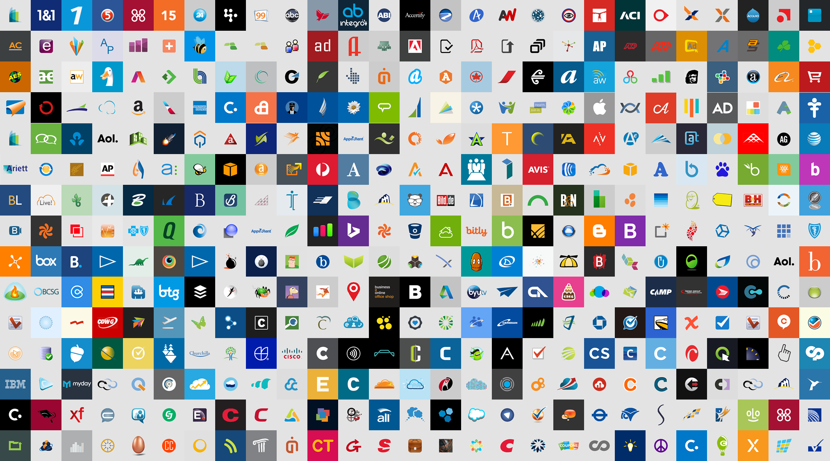








High level architecture – Cloud HR to Microsoft Entra ID / AD
Enable HR-driven user provisioning and automate Joiner/Mover/Leaver processes of employees and contingent workers.
Enterprise SaaS Apps
Microsoft Entra ID
New Employee Hire or New Contingent Worker
Employee / Contingent Worker Termination
Unique ID & Password Generation
Worker Conversion Process
Provisioning Agent
User Attribute Updates
Effective Date based identity lifecycle
Identity Relationships
Mover Processes (Promotions / Org Changes)
On- premises
Notes:
With Microsoft Entra ID provisioning service offering, customers can now setup HR-driven user provisioning from SAP SuccessFactors, so that whenever an identity is created/updated/enabled/disabled in SuccessFactors, that change can flow downstream to your corporate directory servers and to all your enterprise SaaS apps. One of the key advantages of this solution is that it is completely cloud-native, what that means is that all the heavy lifting work of running the provisioning job, applying attribute mappings and managing the service execution is all handled in Entra ID. You don’t need to deploy any on-premises identity management software. It provides out of the box support for several HR scenarios right from future hire provisioning to terminations. Once the identity is created in Microsoft Entra ID, your enterprise SaaS apps connected to Microsoft Entra ID will automatically get the data received from SuccessFactors.
There is also a Writeback mode, that allows your IT admins to writeback IT managed attributes like email and phone number to SAP SuccessFactors. And all these capabilities are available through Microsoft Entra ID P1 / M365 E3 license.

Slide 22
Cloud HR to Microsoft Entra ID

Slide 23
Cloud HR to Microsoft Entra ID
Microsoft Entra ID provisioning Service
Inbound user provisioning
Attribute Writeback
Microsoft Entra ID

Slide 24
Features
Employee is added to Cloud HR: user should be automatically created in Microsoft Entra ID and other SaaS applications that supports user provisioning
Employee attribute updates: When employee record is updated in Cloud HR , their user account in Microsoft Entra ID and supporting SaaS Applications should be automatically updated
Employee Terminations: When employee is terminated in Cloud HR , their user account is automatically disabled in Microsoft Entra ID and supporting SaaS applications
Employee rehires: When Employee is rehired in Cloud HR, customers should have the ability to re-activate or re-provision accounts in Microsoft Entra ID and supporting SaaS applications (depending on customer’s preference)

Slide 25
Planning
Determine the matching ID
This is an important step – since customers get the ability to match existing accounts between source and target systems
What is the unique Identifier in the Cloud HR app?
Discuss how to handle re-hires (re-use employee IDs)
Determine specific lifecycle cases like employees contingent workers, conversions , etc.
Determine account status
Provisioning connector maps the HR user profile status to the user account status
Determine the Joiner / Leaver scenarios and requirements

Slide 26
Planning (Cont’d)
Determine attribute mappings, transformation and scoping filters
How attributes will be mapped to the Microsoft Entra ID user when records are updated in Cloud HR

Slide 27
Deploy POC (Workday to Microsoft Entra ID)
Step | Instructions
1. Select Cloud HR provisioning | Select cloud HR provisioning connector apps
2. Design Provisioning topology | Design provisioning topology
3. Create integration system | Configure integration system user in Workday
4. Add Workday Enterprise App | Workday provisioning connector
5. Configure Workday mappings | Workday and Entra ID attribute mapping
[Optional] Configure Workday Writeback | Configure Workday writeback in Azure Active Directory
6. Enable and Launch provisioning | Enable and launch provisioning

Slide 28
Deploy POC (SuccessFactors to Microsoft Entra ID)
Step | Instructions
1. Select Cloud HR provisioning | Select cloud HR provisioning connector apps
2. Design Provisioning topology | Design provisioning topology
3. Create integration API | Create API user account in SuccessFactors
4. Create permissions for API | Create API permissions in SuccessFactors
5. Add SuccessFactors provisioning connector | Add SuccessFactors inbound connector app
6. Configure Attribute mappings | Configure SuccessFactors attribute mappings
[Optional] Configure SuccessFactors Writeback | Configure attribute write-back from Entra ID to SAP SuccessFactors
7. Enable and launch provisioning | Enable and Launch provisioning

Slide 29
Cloud HR to Active Directory

Slide 30

Cloud HR to Active Directory
Microsoft Entra ID provisioning Service
Inbound user provisioning
Attribute Writeback
Microsoft Entra ID
AAD Connect Provisioning Agent
Active
Directory
AAD Connect

Slide 31
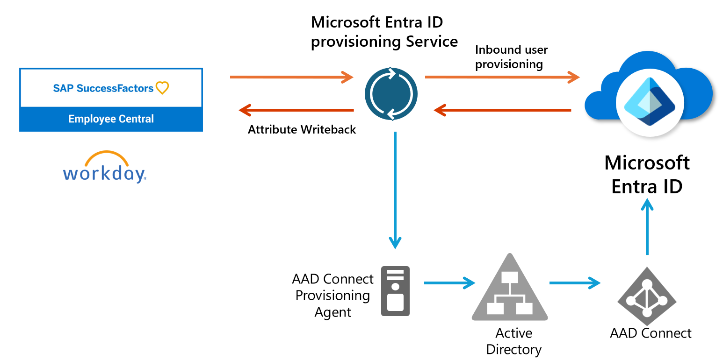







Cloud HR to Active Directory
User data Flow:
The HR team performs worker transactions (Joiners/Movers/Leavers or New Hires/Transfers/Terminations) in Cloud HR
The Microsoft Entra ID Provisioning Service runs scheduled synchronizations of identities from CloudHR and identifies changes that need to be processed for sync with on-premises Active Directory.
The Microsoft Entra ID Provisioning Service invokes the on-premises Microsoft Entra ID Connect Provisioning Agent with a request payload containing AD account create/update/enable/disable operations.
The Microsoft Entra ID Connect Provisioning Agent uses a service account to add/update AD account data.
The Microsoft Entra ID Connect / AD Sync engine runs delta sync to pull updates in AD.
The Active Directory updates are synced with Microsoft Entra ID
If the CloudHR Writeback app is configured, it writes back attributes such as email, username and phone number to CloudHR.

Slide 32
Features
Employee is added to Cloud HR: user should be automatically created in Active Directory, Microsoft Entra ID and other SaaS applications that supports user provisioning
Employee attribute updates: When employee record is updated in Cloud HR , their user account in Active Directory, Microsoft Entra ID and supporting SaaS Applications should be automatically updated
Employee Terminations: When employee is terminated in Cloud HR , their user account is automatically disabled in Active Directory, Microsoft Entra ID and supporting SaaS applications
Employee rehires: When Employee is rehired in Cloud HR, customers should have the ability to re-activate or re-provision accounts in Active Directory, Microsoft Entra ID and supporting SaaS applications (depending on customer’s preference)

Slide 33
Planning
Setup of the Microsoft Entra ID Connect provisioning agent
Number of Workday to AD user provisioning apps to deploy
Selecting the right matching identifier, attribute mapping, transformation and scoping filters

Slide 34
Deploy POC (Workday to Active Directory)
Step | Instructions
1. Select Cloud HR provisioning | Select cloud HR provisioning connector apps
2. Design Provisioning topology | Design provisioning topology
3. Create integration system | Configure integration system user in Workday
4. Configure Workday provisioning App and connectors | Provisioning connector app and Provisioning Agent
5. Install and configure Agents | Install and configure on-prem Agents
6. Configure app connectivity to AD | Configure connectivity to Workday and Active Directory
7. Configure Attribute mappings | Configure attribute mappings
8. Enable and launch provisioning | Enable and launch user provisioning

Slide 35
Deploy POC (SuccessFactors to Active Directory)
Step | Instructions
1. Select Cloud HR provisioning | Select cloud HR provisioning connector apps
2. Design Provisioning topology | Design provisioning topology
3. Create integration system | Configure integration system user in Workday
4. Configure SuccessFactors provisioning App and connectors | SuccessFactors inbound provisioning app and agent
5. Install and configure Agents | Install on-prem agents
6. Configure app connectivity to AD | Configure App connectivity to AD
7. Configure Attribute mappings | Configure attribute mappings
8. Enable and launch provisioning | Enable and launch user provisioning

Slide 36
API-driven inbound user provisioning

Slide 37
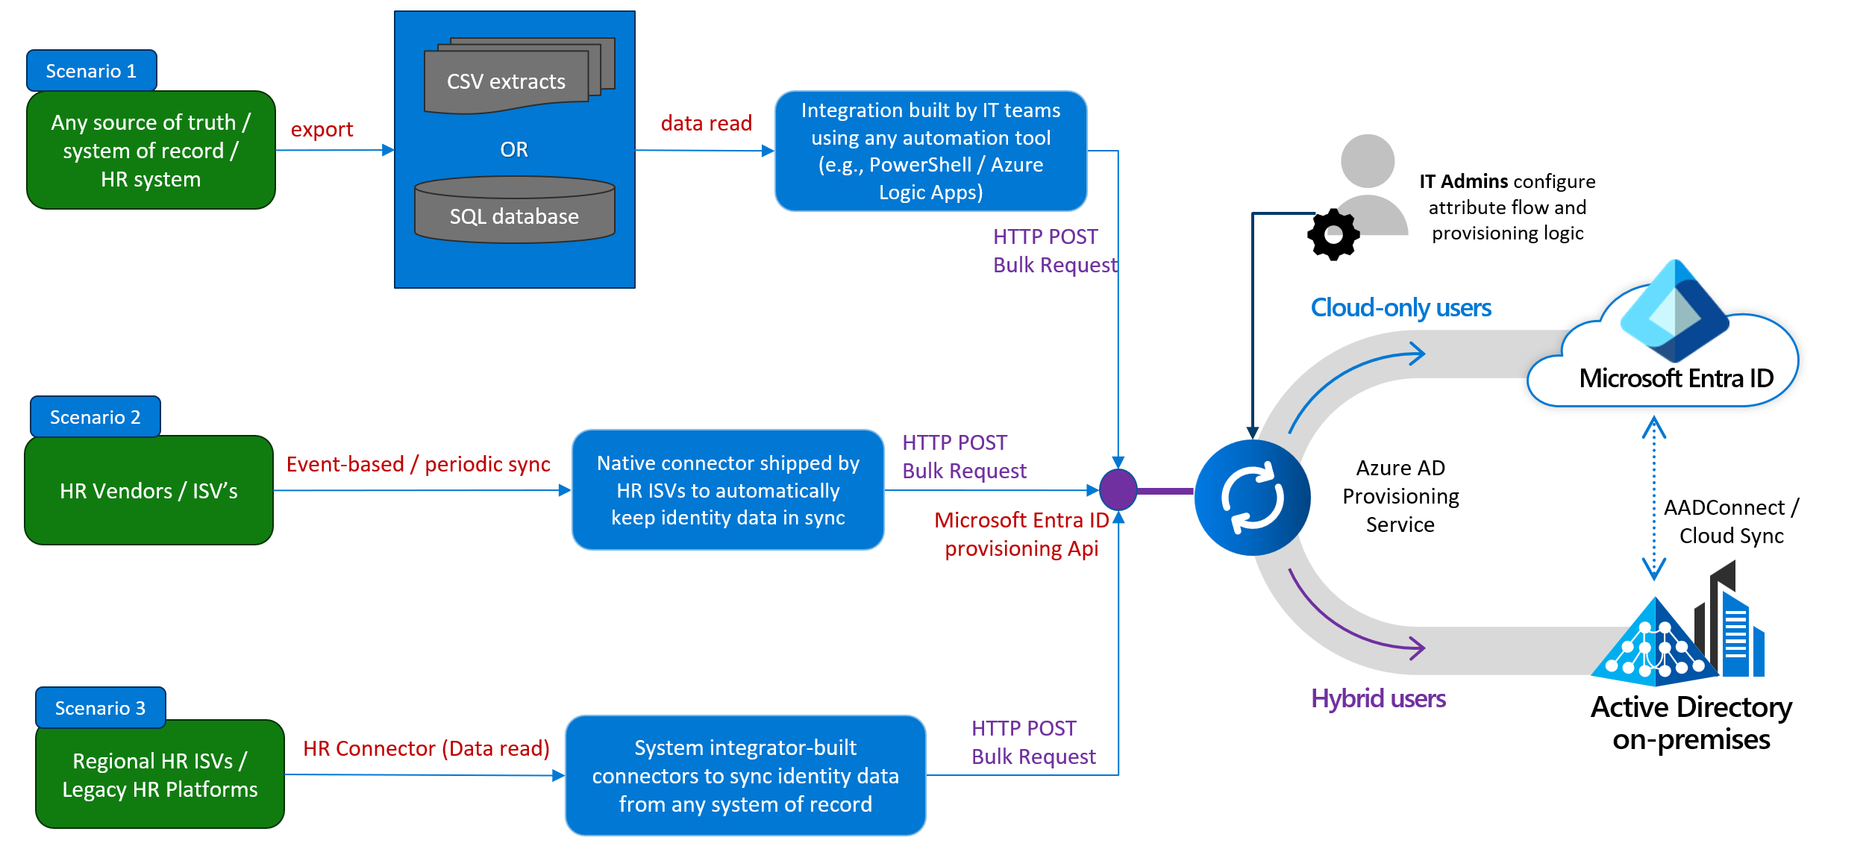
What if my organization doesn’t use Workday or SuccessFactors?
You can use Microsoft Entra ID API-driven provisioning

Slide 38
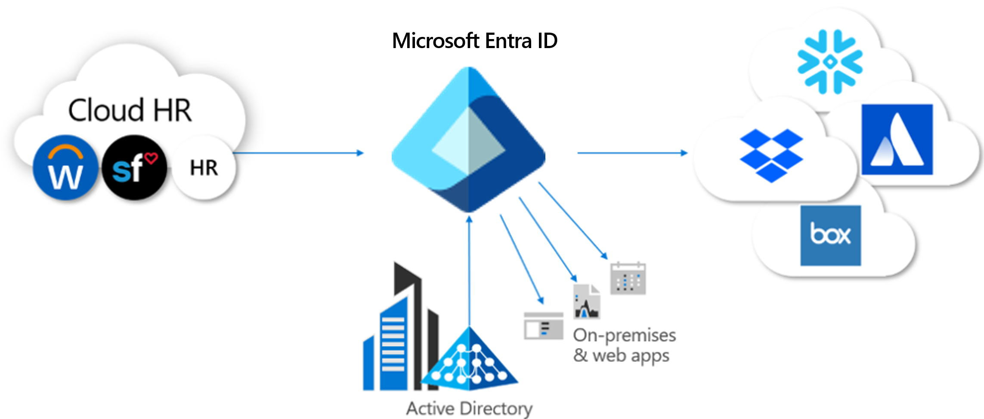
Key Benefits of API-driven user provisioning
Provisioning app in Microsoft Entra ID that uses a valid OAuth token
Admin control through permissions consent
Graph API endpoint that uses SCIM schema constructs.
Can be integrated with multiple data sources
Near real-time Incoming bulk request processing
Admins can check progress through provisioning and API logs
Notes:
Key features of API-driven inbound user provisioning
Delivered as a provisioning app that that exposes an asynchronous Microsoft Graph provisioning /bulkUpload API endpoint accessed using valid OAuth token.
Tenant admins must grant API clients interacting with this provisioning app the Graph permission SynchronizationData-User.Upload.
The Graph API endpoint accepts valid bulk request payloads using SCIM schema constructs.
With SCIM schema extensions, you can send any attribute in the bulk request payload.
The rate limit for the inbound provisioning API is 40 bulk upload requests per second. Each bulk request can contain a maximum of 50 user records, thereby supporting an upload rate of 2000 records per second.
Each API endpoint is associated with a specific provisioning app in Azure AD. You can integrate multiple data sources by creating a provisioning app for each data source.
Incoming bulk request payloads are processed in near real-time.
Admins can check provisioning progress by viewing the provisioning logs.
API clients can track progress by querying provisioning logs API.

Slide 39
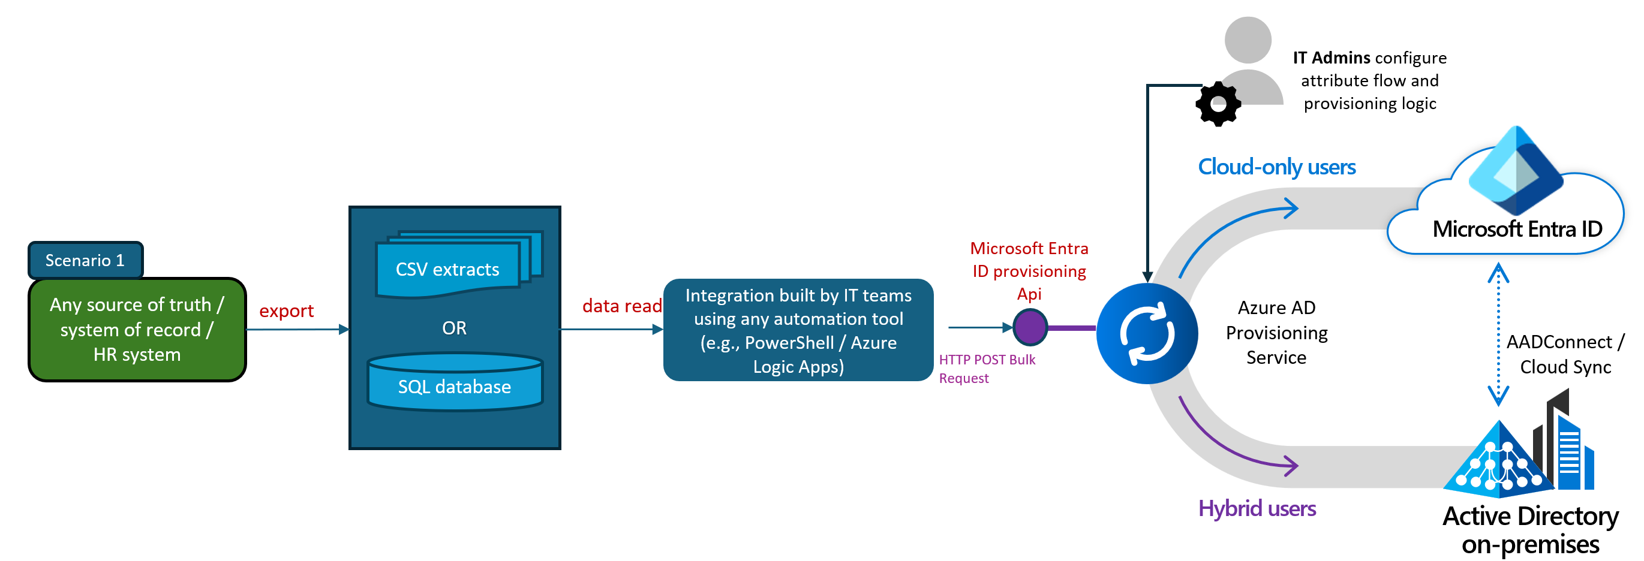
Microsoft Entra ID – API-driven provisioning
Scenario 1: Enable IT teams to import HR data extracts using any automation tool
Commonly used for sources like:
Flat files
CSV files
SQL staging tables
Integration with any automation tool like:
PowerShell scripts
Azure Logic Apps
Workflows using HTTP calls

Slide 40
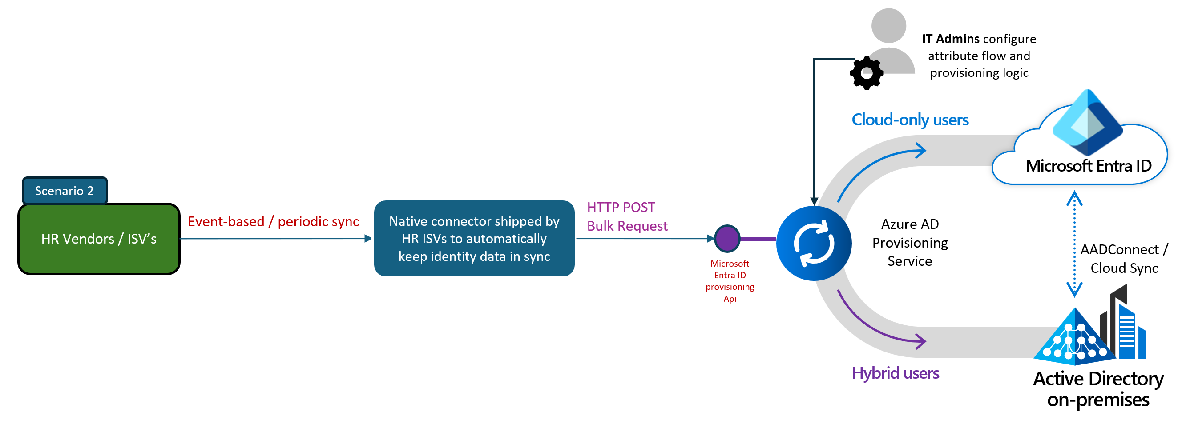
Microsoft Entra ID – API-driven provisioning
Scenario 2: Enable Independent Software Vendors (ISV) to build direct integration with Microsoft Entra ID
Enables HR ISVs to ship native synchronization experiences
Changes in the origin HR system will automatically flow into Microsoft Entra ID and Active Directory domains

Slide 41
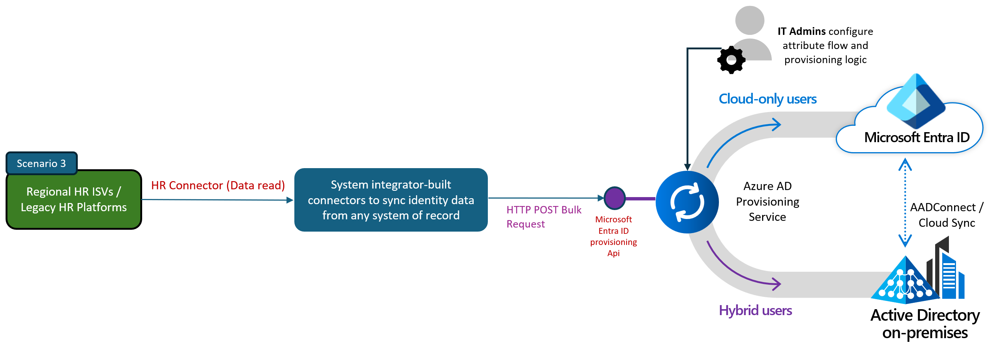
Microsoft Entra ID – API-driven provisioning
Scenario 3: Enable system integrators to build more connectors to systems of record
Partners can build custom HR connectors
Used to meet different requirements around data flows

Slide 42
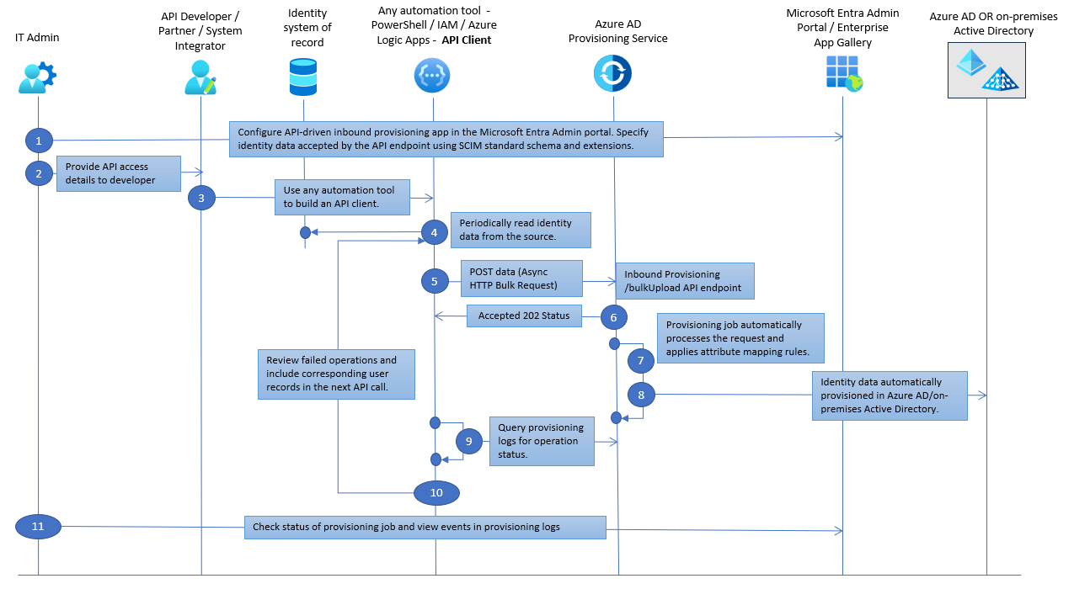
End to End flow
Notes:
Steps of the workflow
IT Admin configures an API-driven inbound user provisioning app from the Microsoft Entra Enterprise App gallery.
IT Admin provides endpoint access details to the API developer/partner/system integrator.
The API developer/partner/system integrator builds an API client to send authoritative identity data to Azure AD.
The API client reads identity data from the authoritative source.
The API client sends a POST request to provisioning /bulkUpload API endpoint associated with the provisioning app. Note
The API client doesn't need to perform any comparisons between the source attributes and the target attribute values to determine what operation (create/update/enable/disable) to invoke. This is automatically handled by the provisioning service. The API client simply uploads the identity data read from the source system by packaging it as bulk request using SCIM schema constructs.
If successful, an Accepted 202 Status is returned.
The Azure AD Provisioning Service processes the data received, applies the attribute mapping rules and completes user provisioning.
Depending on the provisioning app configured, the user is provisioned either into on-premises Active Directory (for hybrid users) or Azure AD (for cloud-only users).
The API Client then queries the provisioning logs API endpoint for the status of each record sent.
If the processing of any record fails, the API client can check the error details and include records corresponding to the failed operations in the next bulk request (step 5).
At any time, the IT Admin can check the status of the provisioning job and view events in the provisioning logs.

Slide 43
How to configure API-drive provisioning
Create a new Enterprise App “API-driven Inbound provisioning to Entra ID” (or API-driven Inbound provisioning to AD” for on-prem provisioning
Configure provisioning Mode and Mappings
Grant access to the inbound provisioning API
Configure a Managed Identity

Slide 44
How is the new inbound provisioning /bulkUpload API different from MS Graph Users API?
There are significant differences between the provisioning /bulkUpload API and the MS Graph Users API endpoint.
Payload format:
The MS Graph Users API endpoint expects data in OData format. The request payload format for the new inbound provisioning /bulkUpload API uses SCIM schema constructs. When invoking this API, set the 'Content-Type' header to application/scim+json.
Operation end-result:
When identity data is sent to the MS Graph Users API endpoint, it's immediately processed, and a Create/Update/Delete operation takes place on the Entra ID user profile.
Request data sent to the provisioning /bulkUpload API is processed asynchronously by the Entra ID provisioning service. The provisioning job applies scoping rules, attribute mapping and transformation configured by the IT admin. This initiates a Create/Update/Delete operation on the Entra ID user profile or the on-premises AD user profile.
IT admin retains control:
With API-driven inbound provisioning, the IT admin has more control on how the incoming identity data is processed and mapped to Entra ID attributes. They can define scoping rules to exclude certain types of identity data (for example, contractor data) and use transformation functions to derive new values before setting the attribute values on the user profile.

Slide 45









API-driven user provisioning and Lifecycle Workflows
Launch mover workflow
Job profile changes (dept, locale)
Launch pre-hire workflow
Launch termination workflow
New worker joins
Worker separates from org
IT Admins configure attribute flow and provisioning logic
Cloud-only users
Microsoft Entra ID
HR Source of record
Inbound Provisioning
{API endpoint}
Microsoft Entra ID Provisioning Service
AADConnect / Cloud Sync
Microsoft Entra ID provisioning Api
Hybrid users
Active Directory
on-premises
Notes:
To help with the offboarding piece with the API-driven provisioning, there are a few options depending on
Lifecycle Workflows are explained later in this document

Slide 46
Deploy POC API-driven inbound provisioning
Step | Instructions
1. Create API-drive provisioning app | API-driven provisioning app
2. Configure API-driven inbound provisioning | AD - Configure API-driven inbound provisioning app AD Microsoft Entra ID - Configure API-driven inbound provisioning app - AAD
3. Grant Access to the inbound provisioning API | Grant access to inbound provisioning API
[Optional] Customize attribute mappings | Customize user provisioning attribute mappings
[Optional] Sync custom attributes | Sync custom attributes
4. Go to next slide for QuickStart samples | Next Slide

Slide 47
QuickStart guides
Title | Link
cURL | Quickstart API-driven inbound provisioning with cURL
Postman | Quickstart API-driven inbound provisioning with Postman
Graph Explorer | Quickstart API-driven inbound provisioning with Graph Explorer
PowerShell | API-driven inbound provisioning with PowerShell
Azure Logic Apps | API-driven inbound provisioning with Azure Logic Apps
FAQ | Frequently asked questions (FAQs) API-driven inbound provisioning

Slide 48









Onboard the user into the directory when the user joins or start working with Contoso
Provisioning user to Apps
Automate the granting of access rights to resources
SaaS apps
On-premises apps
Notes:
Let’s now take a look at the Inboud App provisionoing piece , once we have those users in Microsoft Entra ID

Slide 49
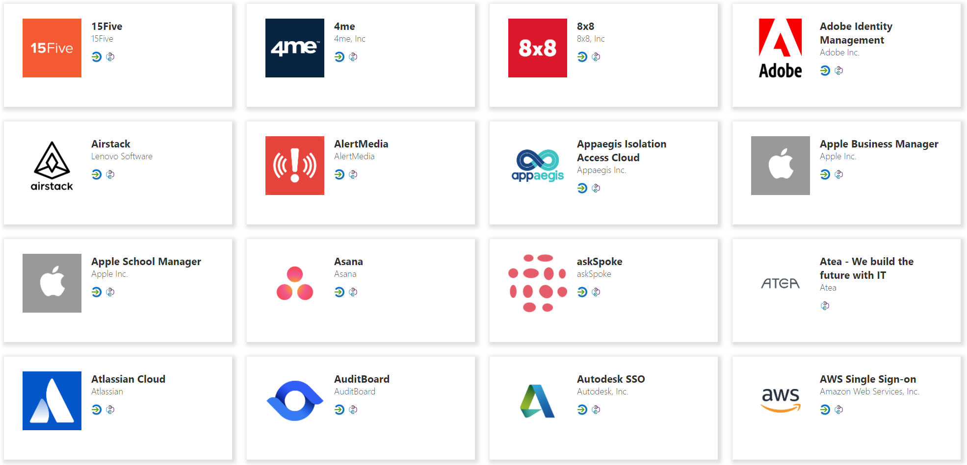
Provisioning to SaaS apps using SCIM
Entra ID
SaaS applications

Slide 50

Features
Automate provisioning
Automate deprovisioning
Synchronize data between systems
Provision groups
Govern access
Seamlessly deploy in brown field scenarios
Use rich customization
Get alerts for critical events
Notes:
Reference: https://docs.microsoft.com/en-us/azure/active-directory/app-provisioning/user-provisioning

Slide 51
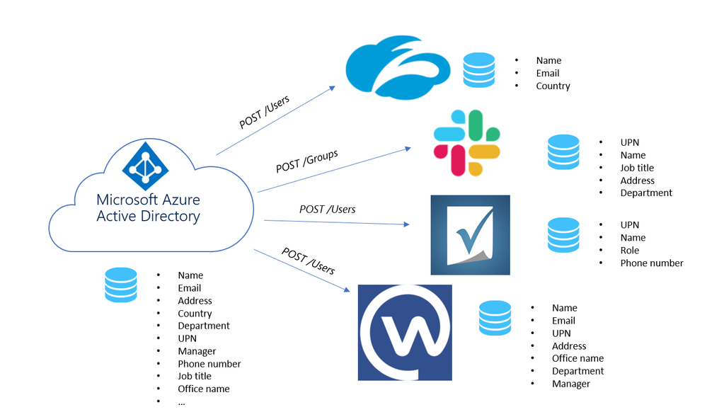
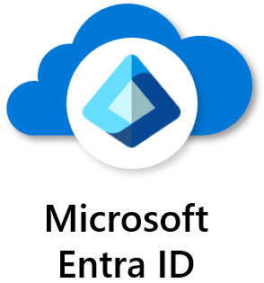
Configure provisioning with SCIM endpoint
SCIM 2.0 is a standardized definition of two endpoints /Users and /Groups

Slide 52
High level steps
Design your user and group schema
Understand the Microsoft Entra ID SCIM implementation
Build a SCIM endpoint
Integrate your SCIM endpoint
Publish your application to the Microsoft Entra ID application gallery
Reference: Microsoft Entra ID - SCIM provisioning Tutorial

Slide 53
Deploy POC SaaS sample app provisioning
Select up to 4 apps
Step | Instructions
Service Now | Configure ServiceNow for automatic user provisioning
Salesforce | Configure Salesforce for automatic user provisioning
Box | Configure Box for automatic user provisioning
Cisco Webex | Configure Cisco Webex for automatic user provisioning
Workplace by Facebook | Configure Workplace by Facebook for automatic user provisioning
Zoom | Configure Zoom for automatic user provisioning

Slide 54




Optional: Provisioning to on-premises applications
Users and schema defined in the cloud
Supports provisioning from custom schema extensions to app-specific properties.
Single sign-on and provisioning
Translation to the provisioning protocols expected by apps
Microsoft-delivered connectors: LDAP, SQL, etc.
Ecosystem of third-party connectors for other apps requiring custom API integrations
Customers can re-use their existing MIM configuration
SCIM
Microsoft Entra ID
provisioning agents
SOAP
LDAP
PS
SQL
Samples: App provisioning samples for SCIM-enabled apps
Notes:
SCIM compliant or SQL or LDAP data store.
Explicit direction to reuse MIM connectors
If you have a MIM connector to an app on prem you can reuse for this provisioning approach, and it will work
https://docs.microsoft.com/azure/active-directory/app-provisioning/on-premises-migrate-microsoft-identity-manager

Slide 55




Lifecycle Workflows
Launch pre-hire workflow
Launch termination workflow
New worker joins
Worker separates from org
Automate join/move/leave employee lifecycle events
Organizations can schedule tasks to occur before, at or after a join or leave date; these can also be run on-demand.
Built-in tasks include generating temporary credentials, sending emails, updating user attributes, and memberships, and removing licenses.
Customers and partners can extend lifecycle workflows with additional tasks via Azure Logic Apps.
Other identity providers
Microsoft Entra ID
Enterprise SaaS apps
HR Systems
On-premises apps
(AD-based)
Active Directory
on-premises
On-premises apps
(non-AD-based)
Notes:
Pre-defined workflow templates for most common user tasks.
Automatic trigger based on attribute state changes of user.
Custom policies for triggering workflows based on pre-defined or custom user states.
Extensibility and flexibility with Logic Apps
On-premises apps include SAML, OpenID Connect, Kerberos, Header-based authN,SCIM-based apps
Directories: AD LDS, 389, Apache, IBM Tivoli, Isode, NetIQ, Novell,
OpenDJ, OpenDS, Oracle, RadiantOne…
Databases: IBM DB2, Oracle, MySQL, SQL Server…

Slide 56
First things first
Synchronize relevant attributes for scheduling triggers
This can be done using things like:
Cloud HR provisioning
Custom import from Active Directory (Sync)
Microsoft Graph (cloud users)
Visit : How to synch attributes for LCW for more information
Attributes needed for this workflow:
employeeHireDate
createdDateTime
employeeLeaveDateTime
Manager (for email to manager tasks)

Slide 57
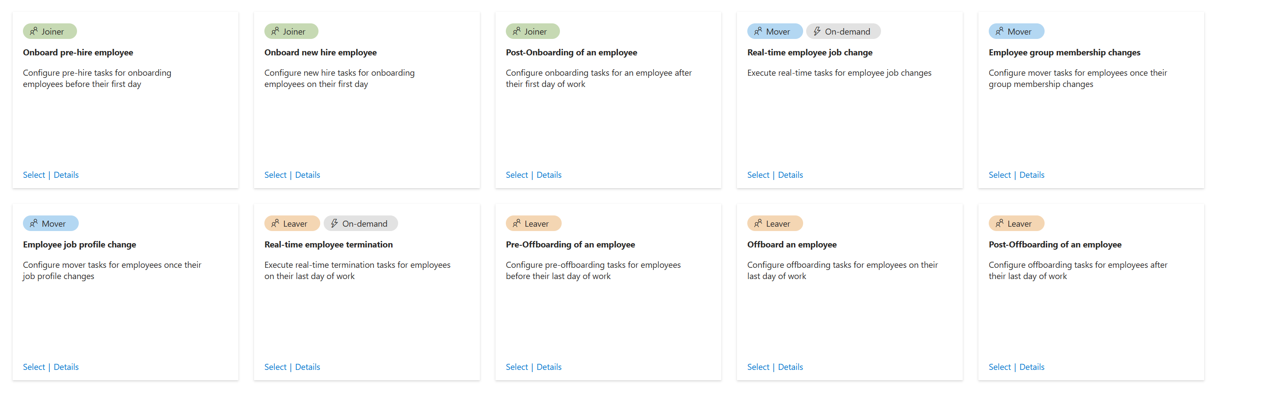
Lifecycle workflows built-in templates

Slide 58


Onboarding Automation
Onboard the user into the directory when the user joins or start working with Contoso
Life Cycle Automation
Notes:
An option to automate the Lifecycle is possible through lifecycle workflows

Slide 59


Joiner scenario Onboarding new users
LCW auto detects users in the user state and triggers workflows
Before Lifecycle Workflows
LCW executes the workflow tasks for the set of users
It can take days for new team members to be fully productive while access to resources is being provisioned.
Onboarding users manually is time consuming for IT and often requires admins to jump between apps and scripts and go through logs in order to find errors.
User provisioned into Entra ID
User onboarded
With Lifecycle Workflows
“Rinse and repeat” templates and automated actions through workflows makes the process more efficient and infallible for IT admins, and faster for new team members.

Slide 60






Joiner scenario - Example
Entra ID
Enterprise SaaS apps
For pre-hire, “X” days before employee’s start date,
‘X’ days before start
Joiner · PRE-HIRE
Create user account (status=disabled)
Send email to onboarding DL
Launch custom Logic Apps workflow
Generate Temporary Access Pass (TAP)
Send email to hiring manager with TAP
On the employee’s start date, perform the following tasks.
On start date
Joiner · HIRE
On start date
Enable user account
Group assignments
Send welcome email to new hire
Add user to Teams “New Hires” channel
Employee’s day 1 and Manager shares the temporary access pass.
On Day 1
Joiner · WELCOME
On start date
Login with temporary access pass
Setup passwordless sign-in Windows Hello / FIDO key
Welcome messages in Teams channel
“Best onboarding experience ever!”

Slide 61
Lifecycle workflows built-in templates

Slide 62
Planning – Define Parameters
Onboarding Pre-hire employee customization
Tasks to be completed by the workflow (Generate TAP and send email)
Trigger types - Time based attribute, Attribute changes, Group Membership change
Execution conditions (Rule based on attributes)
Onboarding New-hire employee customization
Tasks to be completed by the workflow (Add User To Group, Enable User Account, Send Welcome Email)
Trigger types - Time based attribute, Attribute changes, Group Membership change
Execution conditions (Rule based on attributes)
Post-onboarding employee customization
Tasks to be completed by the workflow (Add User To Group, Add user to selected teams)
Trigger types - Time based attribute, Attribute changes, Group Membership change
Execution conditions (Rule based on attributes)

Slide 63
Make sure that tasks are completed immediately when an employee changes roles in Contoso
Employee Change (Mover)
Life Cycle Automation

Slide 64
Lifecycle workflows built-in templates

Slide 65
Planning – Define Parameters
Employee job profile change
Tasks to be completed by the workflow (Email to notify manager, Remove users from groups, etc.. )
Trigger types - Attribute changes, Group Membership change
Real-time employee termination
Tasks to be completed by the workflow (Remove user from all groups/Teams, Delete account)
To run on-demand (Emergency termination)
Employee Group membership changes
Tasks to be completed by the workflow (Remove access package assignment for user, Remove user from selected Teams)
Trigger types - Attribute changes, Group Membership change
Execution conditions (Rule based on attributes)

Slide 66
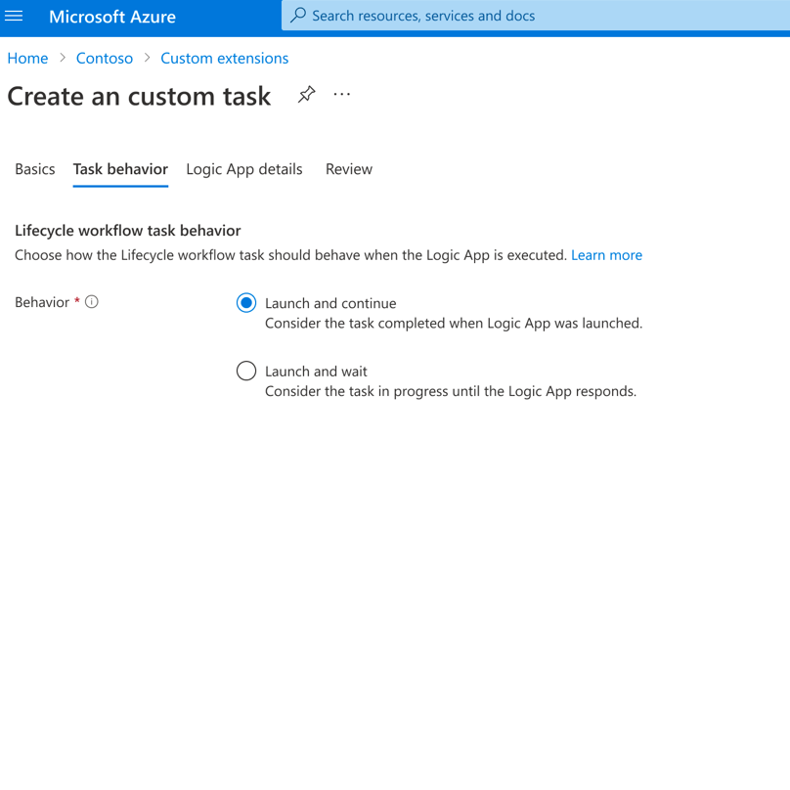
Lifecycle Workflows custom task extension
Utilize these extensions to call-out external systems with Logic apps as part of the workflow

Slide 67
Make sure access rights are removed when user leaves or stops working with Contoso
Employee Termination
Life Cycle Automation
Notes:
Let’s discuss the first step of the journey from our Identity lifecycle approach: Onboarding users into our Microsoft Entra ID directory

Slide 68


Leaver scenario Offboarding users
LCW auto detects users in the user state and triggers workflows
Before Lifecycle Workflows
LCW executes the workflow tasks for the set of users
When team members leave the organization, their personal information must be handled in compliance with regulations and policies, it is also important to reduce the risk for organizations for potential data unauthorized access after termination
This puts pressure on IT and compliance teams to ensure that all resource access is removed from the former employee without impacting the organization.
User leaving the organization
User offboarded
With Lifecycle Workflows
Using customizable workflow templates for common offboarding tasks ensures timely, reliable, graceful resource access removal for IT, and peace of mind for former team members.
Notes:
Tasks for departing employees are also time-consuming and inefficient. Here’s where Microsoft Entra ID Governance Lifecycle Workflows can help, with customizable workflow templates for common termination tasks that can be scheduled and also run on-demand. IT admins and users can experience a seamless offboarding process.

Slide 69





Leaver scenario - Example
For pre-leaver, “X” days before employee’s last day.
Leaver · Pre-Termination
14 days before last day
Send reminder email to manager
Launch custom Logic Apps workflow
Remove user from selected Teams
Remove selected
Groups
On the employee’s last day, perform the following tasks.
On Last Day
Block user sign-in
Remove user from all Teams channels
Remove all Group assignments
Send reminder email to manager
Leaver · Termination
Upon an employee’s real-time termination
Real-time
Block user sign-in
Remove all Group assignments
Send termination email to team
Remove user from all Teams channels
Leaver · Emergency Termination
For post-leaver, “X” days after employee’s last day.
Leaver · Post-Termination
30 days after last day
Remove all license assignments
Remove user from all Teams channels
Launch custom Logic Apps workflow
Delete user account

Slide 70
Lifecycle workflows built-in templates

Slide 71
Planning – Define Parameters
Pre-Offboarding of an employee
Tasks to be completed by the workflow (Remove user from all groups/Teams)
Trigger types - Time based attribute, Attribute changes, Group Membership change
Real-time employee termination
Tasks to be completed by the workflow (Remove user from all groups/Teams, Delete account)
To run on-demand (Emergency termination)
Offboard an employee
Tasks to be completed by the workflow (Disable User Account, Remove user from all groups/Teams)
Trigger types - Time based attribute, Attribute changes, Group Membership change
Execution conditions (Rule based on attributes)

Slide 72
Planning – Define Parameters (Cont’d)
Post-Offboarding of an employee
Tasks to be completed by the workflow (Remove all licenses for user, Remove user from all Teams, Delete User Account)
Trigger types - Time based attribute, Attribute changes, Group Membership change
Execution conditions (Rule based on attributes)

Slide 73
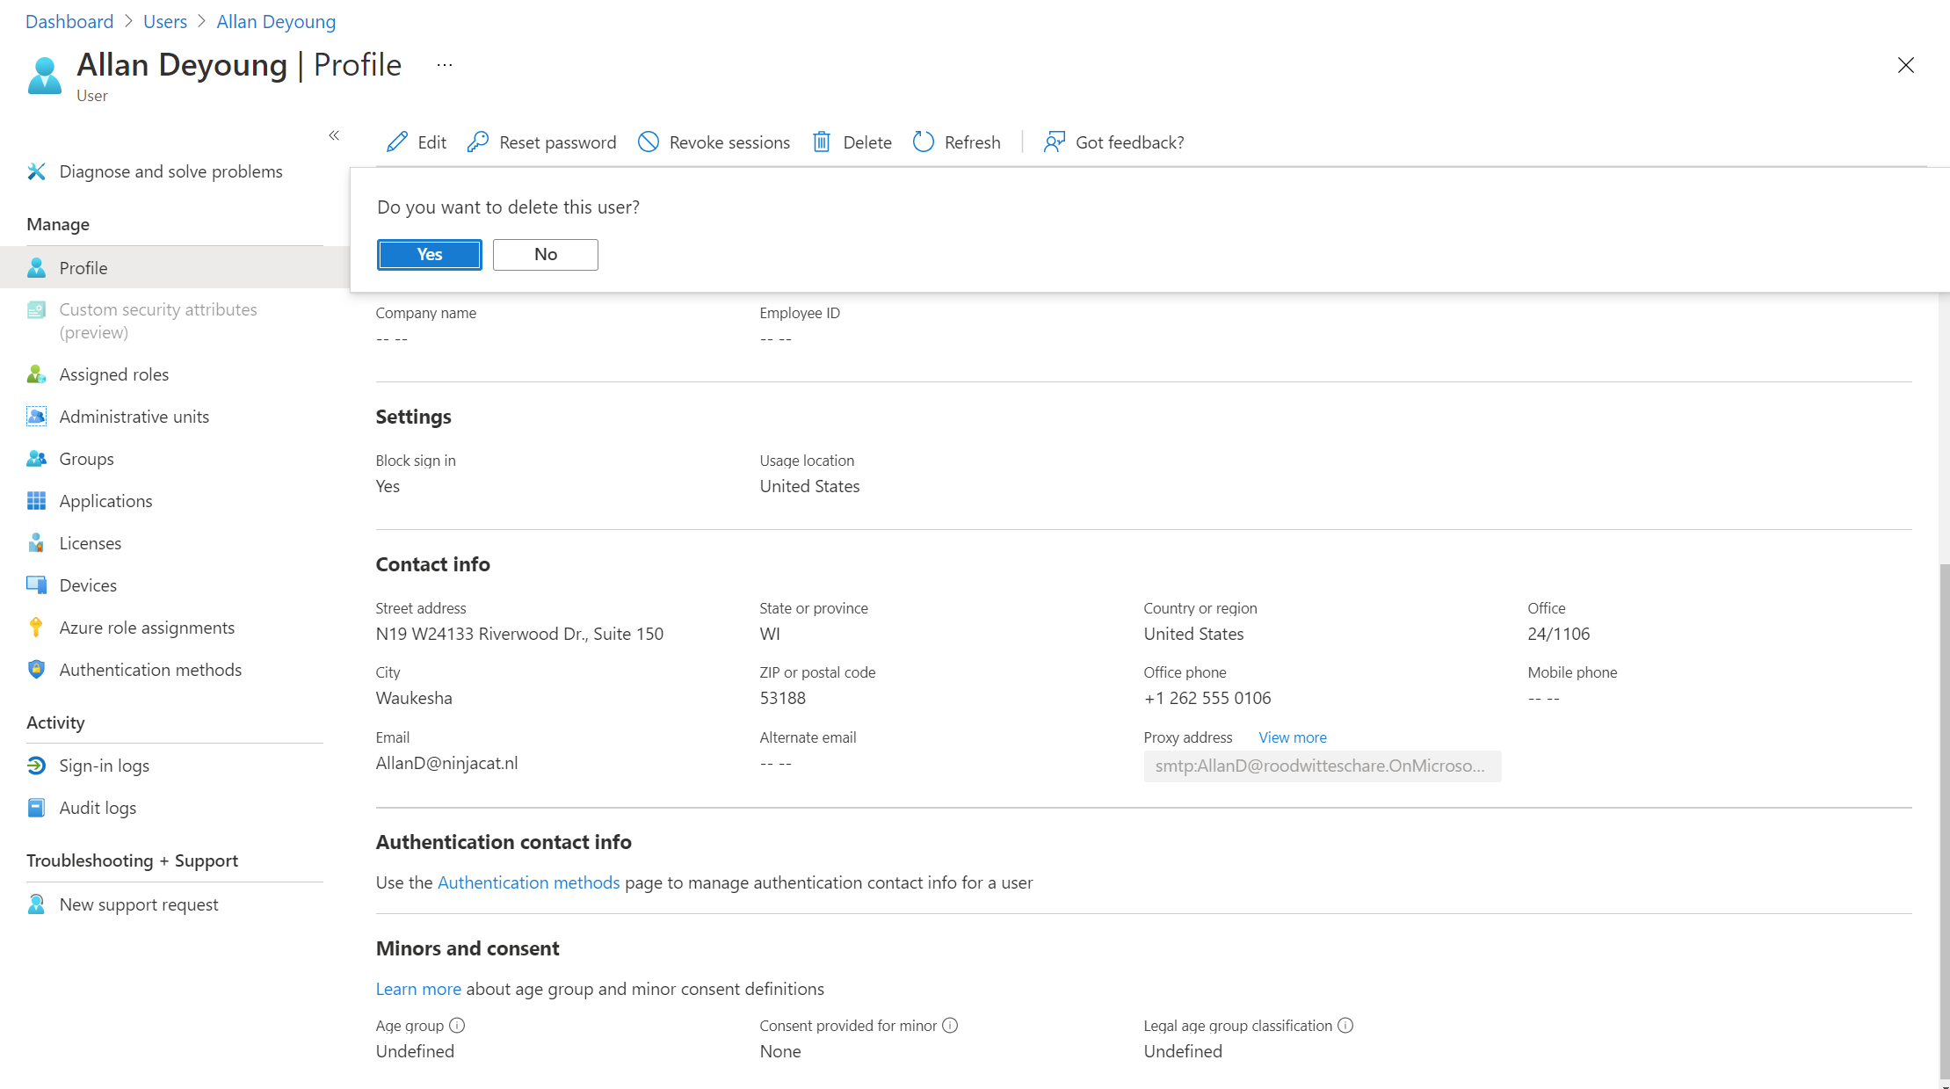
Removing access
Applications
Microsoft Entra ID provisioning service keeps source and target systems in sync
De-provisioning accounts when users should not have access anymore:
The user account is deleted in Entra ID
The user is unassigned from the application
The user no longer meets a scoping filter and goes out of scope
The AccountEnabled property is set to False
Soft delete a user by default if the application supports soft deletes

Slide 74
Lifecycle Workflows custom extensions
Allows you to create workflows using extensions like Logic Apps. With the extensibility feature, you're able to utilize the concept of custom task extensions to call-out to external systems as part of a workflow.
For example, when a user joins your organization, you can have a workflow with a custom task extension that assigns a Teams number, or have a separate workflow that grants access to an email account for a manager when a user leaves
Prerequisites:
An Azure subscription
A resource group
Permissions to create a new consumption-based Logic App or access to an existing consumption-based Logic App

Slide 75


Azure logic Apps high-level steps
Create a consumption-based Azure Logic App
Configure the Azure Logic App so its compatible with Lifecycle workflows
Build your custom business logic within your Azure Logic App
Create a lifecycle workflow customTaskExtension which holds necessary information about the Azure Logic App
Update or create a Lifecycle workflow with the “Run a custom task extension” task, referencing your created customTaskExtension

Slide 76
POC Deployment - Lifecycle Workflows (LCW)
Title | Link
1. How to sync attributes for LCW | Sync attributes for Lifecycle Workflows
2. Prepare user accounts | Prepare user accounts for LCW
3. Onboard pre-hire employee | Automate pre-hire tasks for an employee
4. Onboard new hire employee | Automate Onboarding a new employee
5. Post-Onboarding of an employee | Automate Post-Onboarding of an employee
6. Real-time employee change | Real time employee change
7. Real-time employee termination | Real time employee termination
8. Pre-Offboarding of an employee | Automate Pre-Offboarding of an employee
9. Offboard an employee | Automate Offboarding of an employee
10. Post-Offboarding of an employee | Automate Post-Offboarding of an employee
[Optional] – Trigger Logic Apps based on custom extensions | Trigger LogicApps with custom extensions

Slide 77
Supported Tasks and workflows
Task | Category
Send welcome email to new hire | Joiner
Send onboarding reminder email | Joiner
Generate Temporary Access Pass and send via email to user's manager | Joiner
Send email to notify manager of user move | Mover
Request user access package assignment | Joiner, Mover
Add user to groups | Joiner, Leaver, Mover
Add user to teams | Joiner, Leaver, Mover
Enable user account | Joiner, Leaver
Run a custom task extension | Joiner, Leaver, Mover
Disable user account | Leaver
Remove user from selected group | Joiner, Leaver, Mover
Remove users from all groups | Leaver
Remove user from teams | Leaver
Remove user from all teams | Leaver
Remove access package assignment for user | Leaver, Mover
Remove all access package assignments for user | Leaver
Cancel all pending access package assignment requests for user | Leaver
Remove all license assignments from user | Leaver
Delete user | Leaver
Send email to manager before user's last day | Leaver
Send email on user's last day | Leaver
Send email to user's manager after their last day | Leaver

Slide 78

Thank you

